Slide 1
Cloud Computing Basics
Day 02

Slide 2
Installing WordPREss

Slide 3
Install WordPress
If you want to try your stack, install a sample app. As an example, the following steps install the open source WordPress platform to create websites and blogs. Other workloads to try include Drupal and Moodle.
This WordPress setup is only for proof of concept.

Slide 4
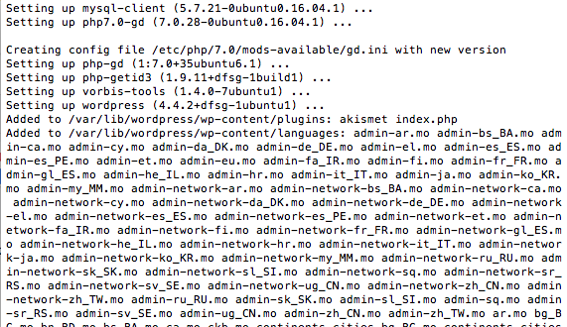
Install the WordPress package
Run the following command:
sudo apt install wordpress

Slide 5
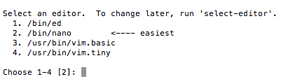
Configure Wordpress
In a working directory, create a text file wordpress.sql to configure the MySQL database for WordPress:
sudo sensible-editor wordpress.sql
When you are asked for an editor select 2

Slide 6
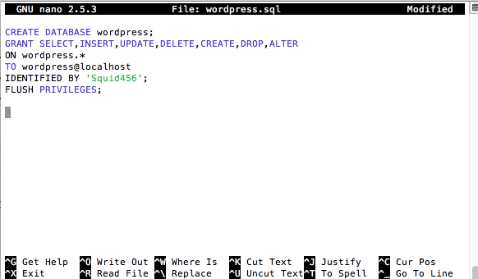
Configure Wordpress
Add the following commands, substituting a database password of your choice for yourPassword (leave other values unchanged). If you previously set up a MySQL security policy to validate password strength, make sure the password meets the strength requirements. Save the file (CTRL-O).
CREATE DATABASE wordpress;
GRANT SELECT,INSERT,UPDATE,DELETE,CREATE,DROP,ALTER
ON wordpress.*
TO wordpress@localhost
IDENTIFIED BY 'yourPassword';
FLUSH PRIVILEGES;

Slide 7
Nano Text Editor on Linux

Slide 8
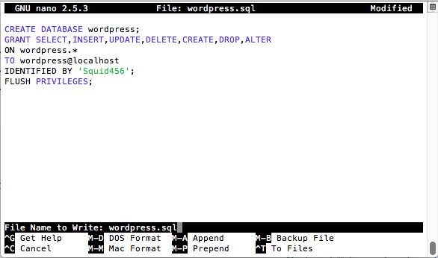
Nano Text Editor – Save (Press CTRL-o)

Slide 9
Create the Database
After creating the database script run the following command to create the database in mySQL:
cat wordpress.sql | sudo mysql --defaults-extra-file=/etc/mysql/debian.cnf

Slide 10
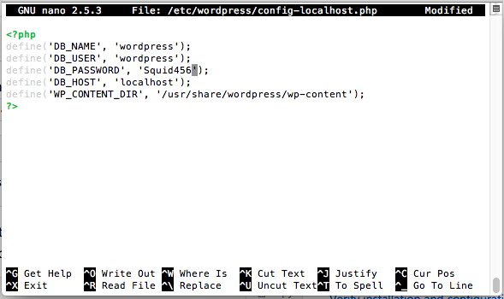
Configure PHP
To configure PHP, run the following command to open a text editor of your choice and create the file /etc/wordpress/config-localhost.php, save when you are done:
sudo sensible-editor /etc/wordpress/config-localhost.php

Slide 11
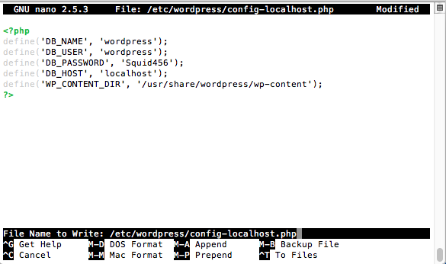
Configure PHP
Copy the following lines to the file, substituting your WordPress database password for yourPassword (leave other values unchanged). Then save the file.
<?php
define('DB_NAME', 'wordpress');
define('DB_USER', 'wordpress');
define('DB_PASSWORD', 'yourPassword');
define('DB_HOST', 'localhost');
define('WP_CONTENT_DIR', '/usr/share/wordpress/wp-content');
?>

Slide 12
Move WordPress files to proper folders
Move the WordPress installation to the web server document root:
sudo ln -s /usr/share/wordpress /var/www/html/wordpress
sudo mv /etc/wordpress/config-localhost.php /etc/wordpress/config-default.php

Slide 13
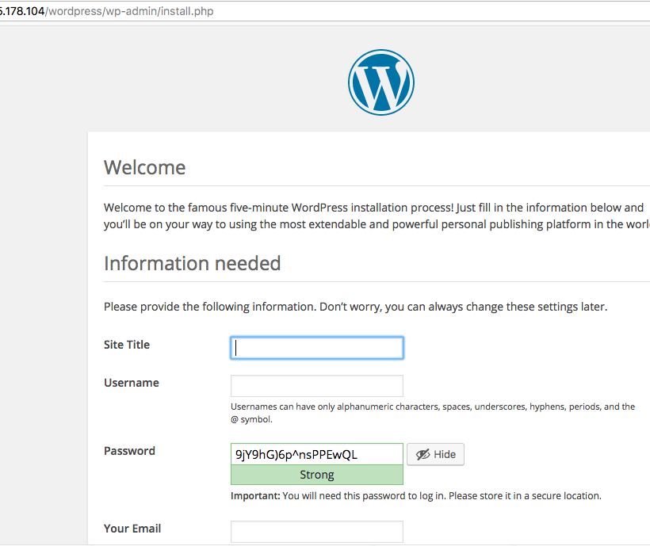
Complete the Installation
Now you can complete the WordPress setup and publish on the platform.
Open a browser and go to http://yourPublicIPAddress/wordpress. Substitute the public IP address of your VM. It should look similar to this image.

Slide 14
Congratulations!
You Have Now Installed an Application on your Virtual Server
This is just a proof of concept and is by no means a secured WordPress Install

Slide 15

STOP!
Do The Quiz to check what you’ve picked up!
A link will be shown on screen

Slide 16
Summary
Cloud Computing
Public vs. Private vs. Hybrid Cloud
SaaS, PaaS, IaaS
ePLDT cloud services
SDN
IoT

Slide 17
Ronald L. Ramos
Contact Info
eMail: rlramos@smart.com.ph
Cell: 09298874076

Slide 18
Thank You!

Slide 19
End of Day 3

