Slide 1
Cloud Computing Basics

Slide 2
Introductions

Slide 3
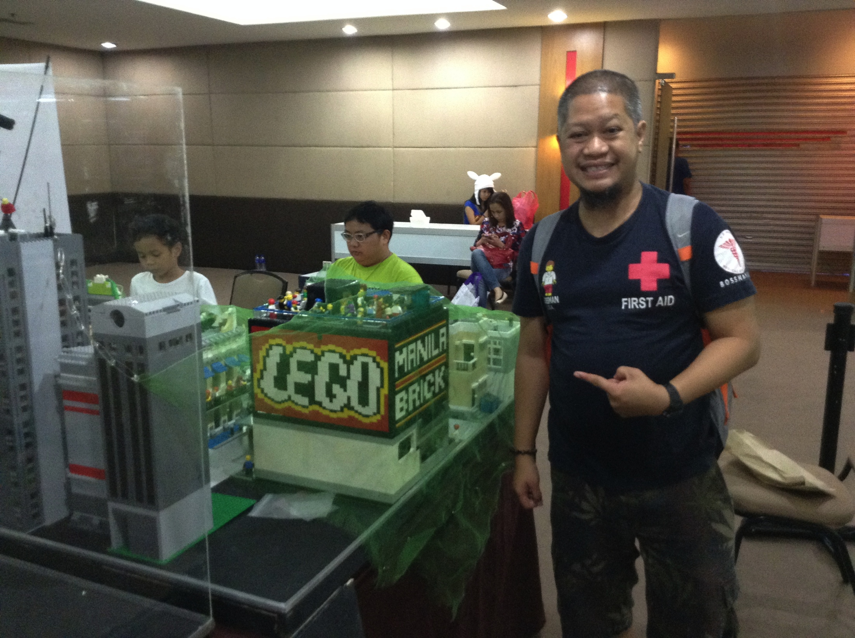

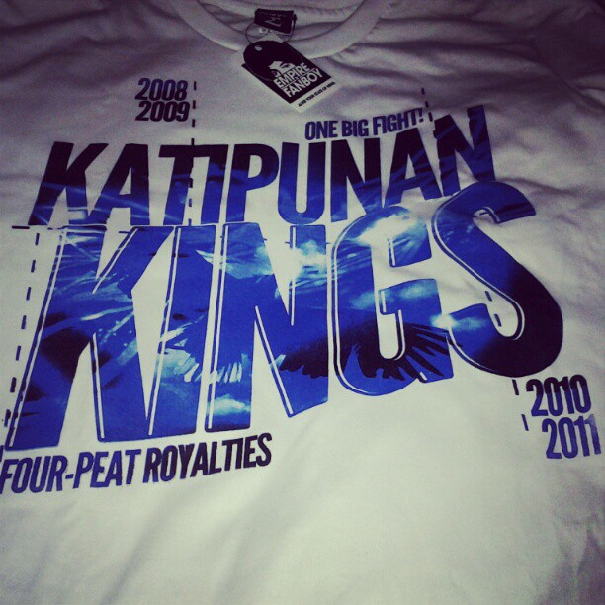

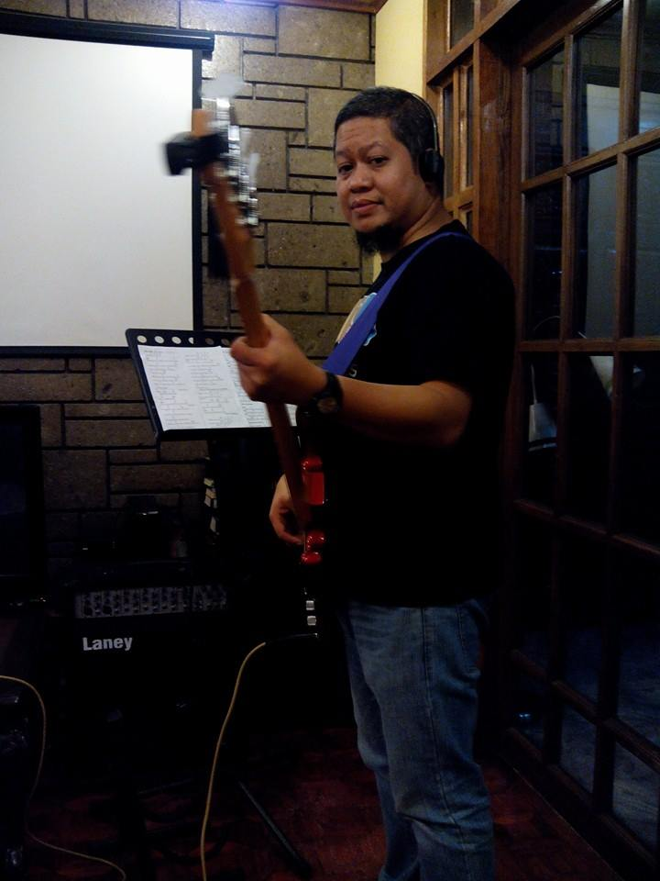

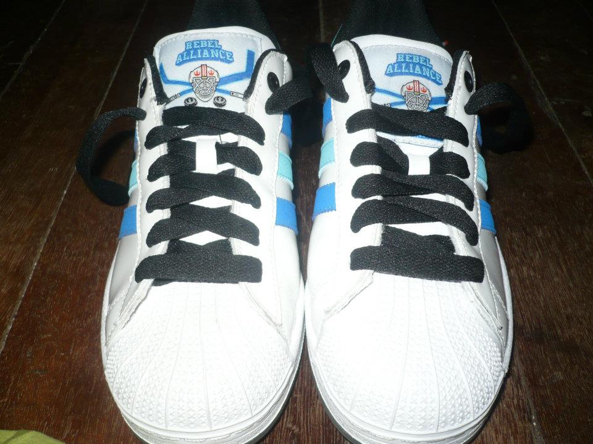

Ronald L. Ramos

Slide 4
Getting to know you
Name
Nickname
IT Experience?
Name one thing that interests you about Cloud Computing

Slide 5
Our World Today

Slide 6
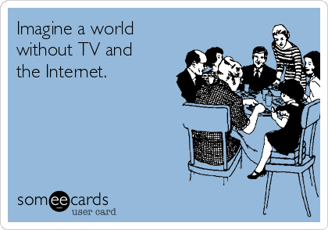

Slide 7
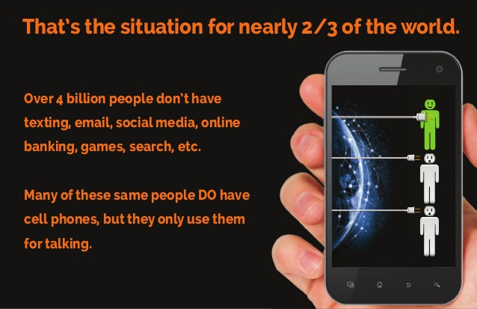

Slide 8
Technology Trends

Slide 9
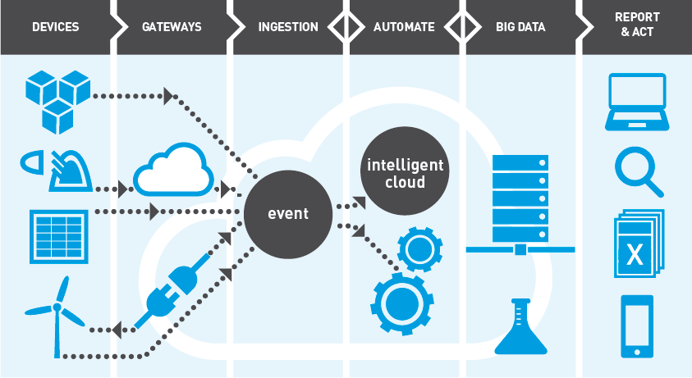
Internet of Things (IoT)
"Anything that can be connected, will be connected."
Notes:
Video
https://www.youtube.com/watch?v=ZgWbWCv0J5E → A Day in the Life of IoT
https://www.codit.eu/how-can-we-help/internet-of-things/
https://www.youtube.com/watch?v=l6bwYSadPTA → Iot Overview (Teradata)

Slide 10
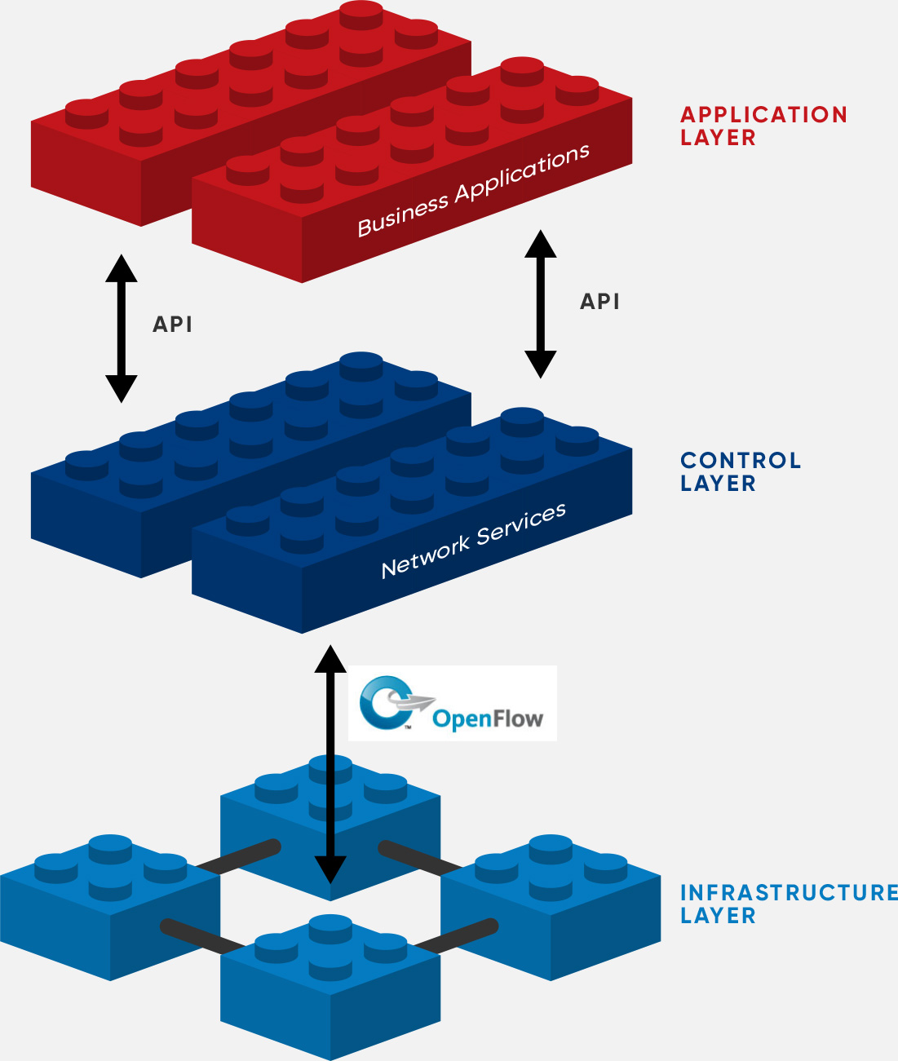
SDN
Software-Defined Networking (SDN) is an emerging architecture that is dynamic, manageable, cost-effective, and adaptable, making it ideal for the high-bandwidth, dynamic nature of today’s applications.
This architecture decouples the network control and forwarding functions enabling the network control to become directly programmable and the underlying infrastructure to be abstracted for applications and network services
Notes:
Video to be shown to class:
https://www.youtube.com/watch?v=Z5Gi2Bpd82M → What is software-defined networking (SDN)?
Additional Information:
https://www.youtube.com/watch?v=SQhrKu1aN2g → SDN less than 60 seconds
NFV – Network Function Virtualization
https://www.opennetworking.org/sdn-definition/
https://www.networkworld.com/article/3209131/lan-wan/what-sdn-is-and-where-its-going.html
The SDN Architecture is:
DIRECTLY PROGRAMMABLE
Network control is directly programmable because it is decoupled from forwarding functions.
AGILE
Abstracting control from forwarding lets administrators dynamically adjust network-wide traffic flow to meet changing needs.
CENTRALLY MANAGED
Network intelligence is (logically) centralized in software-based SDN controllers that maintain a global view of the network, which appears to applications and policy engines as a single, logical switch.
PROGRAMMATICALLY CONFIGURED
SDN lets network managers configure, manage, secure, and optimize network resources very quickly via dynamic, automated SDN programs, which they can write themselves because the programs do not depend on proprietary software.
OPEN STANDARDS-BASED AND VENDOR-NEUTRAL
When implemented through open standards, SDN simplifies network design and operation because instructions are provided by SDN controllers instead of multiple, vendor-specific devices and protocols.

Slide 11
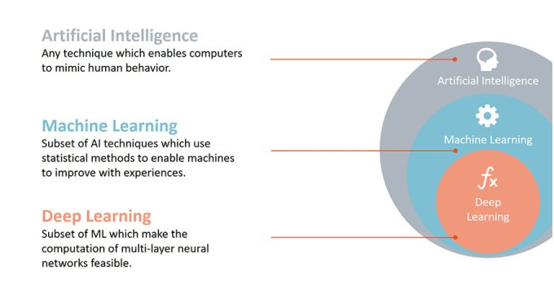
Artificial Intelligence/ Machine Learning/ Big Data
Notes:
VIDEO:
https://www.youtube.com/watch?v=zjeBGkS4LAA → AI in 101 seconds
https://www.youtube.com/watch?v=-SgkLEuhfbg → Machine Learning versus Deep Learning
https://www.youtube.com/watch?v=fvtrRGmv7aU → What is AI? BBC
https://www.youtube.com/watch?v=zjeBGkS4LAA → AI in 101 seconds
https://www.youtube.com/watch?v=ROaw4if2o7E → What are AI and Big Data?
Artificial intelligence (AI) is an area of computer science that emphasizes the creation of intelligent machines that work and react like humans.

Slide 12
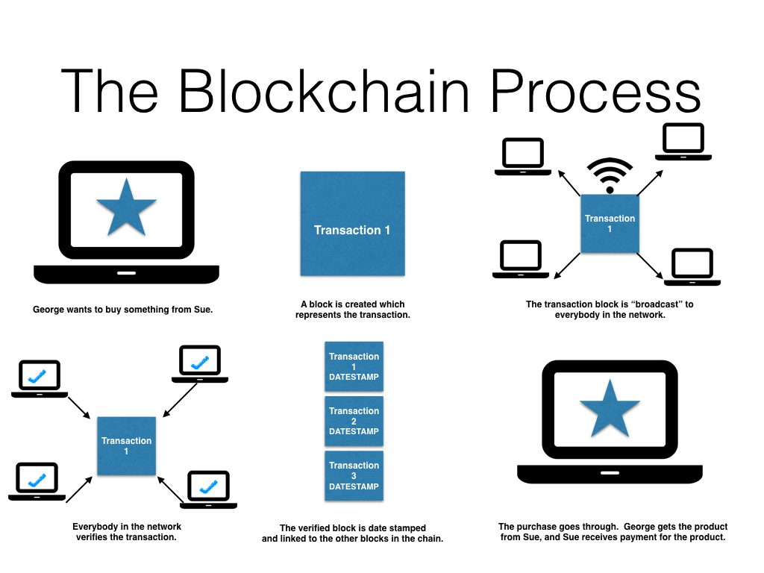
Blockchain
The technology behind Bitcoin and many other cryptocurrencies is a distributed ledger database for recording transactions, more commonly known as blocks.
Notes:
https://www.youtube.com/watch?v=lD9KAnkZUjU
http://usblogs.pwc.com/emerging-technology/a-primer-on-blockchain-infographic/

Slide 13
The Cloud

Slide 14

1996
Inside the offices of Compaq Computer, a small group of technology executives was plotting the future of the Internet business and calling it “cloud computing.”
Their vision was detailed and prescient. Not only would all business software move to the Web, but what they termed “cloud computing-enabled applications” like consumer file storage would become common.
Notes:
For two men in the room, a Compaq marketing executive named George Favaloro and a young technologist named Sean O’Sullivan, cloud computing would have dramatically different outcomes. For Compaq, it was the start of a $2-billion-a-year business selling servers to Internet providers. For O’Sullivan’s startup venture, it was a step toward disenchantment and insolvency.

Slide 15
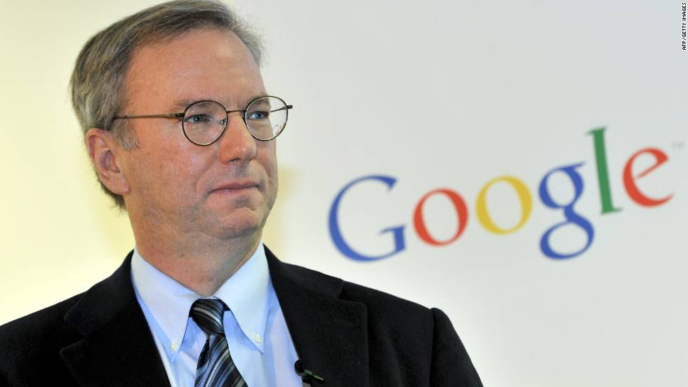
“What’s interesting [now] is that there is an emergent new model, I don’t think people have really understood how big this opportunity really is. It starts with the premise that the data services and architecture should be on servers. We call it cloud computing—they should be in a “cloud” somewhere.” - Eric Schmidt, Google CEO, 2006

Slide 16
What is cloud computing?
“Cloud Computing” is the on-demand delivery of IT resources and applications via the Internet.
Notes:
Instead of buying, owning and maintaining your own data centers and servers. Organizations can acquire technology such as compute power, storage, databases and other services on as needed basis.

Slide 17
How are applications deployed in pre-Cloud era?
Check the specs needed by the App
Install servers in a data center (in-house or provider)
Install apps in servers
Purchase servers (with buffer)
Wait for delivery

Slide 18
What is cloud computing?
Pricing model is via pay-per-use, so you only pay what you use.
Notes:
It it similar to how consumers flip a switch to turn on lights in their home and the power company sends electricity. With Cloud Computing, ePLDT manages and maintains the technology infrastructure in a secure environment and businesses access these resources via the internet to build and run their application. Capacity can grow and shrink instantly and the user only pay for what they use.

Slide 19
Key Cloud Elements
Accessed via a Network
Can Grow or Shrink
Running on Shared Resources
Pay as You Go
Easy to Setup

Slide 20
Key Cloud Elements
Applications use Cloud as their backend infrastructure

Slide 21
Key Cloud Elements
ePLDT Cloud runs through Vitro network of Data Centers

Slide 22
Rationale for Cloud Computing
Cloud computing offers a value proposition that is different from traditional enterprise IT environments.
By providing a way to exploit technologies such as virtualization, application containers, and serverless computing which aggregate and share computing resources, cloud computing can offer economies of scale that would otherwise be unavailable.
With minimal upfront investment, cloud computing enables global reach of services and information through an elastic utility computing environment that supports on-demand scalability.
Cloud computing can also offer pre-built solutions and services, backed by the skills necessary to run and maintain them, potentially lowering risk and removing the need for the organization to retain a group of scarce highly-skilled staff.
Notes:
Cloud computing does not exist in a vacuum. Most organizations have a broad variety of applications already running in their data center. For most, cloud computing will extend their existing IT infrastructure. Cloud computing can be dedicated to particular tasks. It can be used mainly for new projects or an organization may use it for surge demand, guaranteeing a certain level of performance for enterprise computing.

Slide 23

STOP!
For 5-10 minutes form groups of 5
Discuss within your groups 5 examples of Cloud Computing aside from Google products that you have experienced and used
Be Prepared to present to class a summary of your discussion

Slide 24
5 Examples of Cloud Computing
eMail
Online Storage
Extra Processing Power
Collaboration
Virtual Offices
Notes:
https://www.technobuffalo.com/2010/01/17/five-examples-of-cloud-computing/
eMail:
Email communication now plays a central role in most of our busy lives. That’s fine if you don’t go out much but if you travel a lot, this may cause problems. Unless you carry a mobile WiFi-enabled laptop with you everywhere you go or use push email on your cellphone, having an email client sitting on your computer at home means that while out and about you risk spending time outside of the communication loop. This is one area where the cloud finds its most frequent and useful application.
Online email has been offered by all the big names (such as Microsoft, Yahoo and of course Google) for a number of years and I have tried a lot of different services. Wherever in the world I have found myself, my emails have (almost) always been made available to me. The easiest and most convenient for me is GoogleMail, although each has its pros and cons.
Of course, using webmail makes you a slave to an internet connection. The first thing you do when you find yourself in a new or unfamiliar location is to try and locate an internet café or public library to launch your secure portable browser and check your emails. Privacy concerns are never far from the surface either, especially when stories of passwords to private accounts being leaked online hit the headlines. How much of your life have you given away during email exchanges?
And then there’s the issue of possible data loss, which nicely leads onto the next incarnation of cloud computing.
Online Storage:
Data stored on your home or business computer suffers from many of the same restrictions as email and, as with email, the cloud offers a solution. Storing your MP3’s, video, photos and documents online instead of at home gives you the freedom to access them wherever you can find the means to get online.
True, you will undoubtedly be putting your life ‘out there’ and with that comes all the security and privacy baggage that also plague webmail. Most, if not all, online storage facilities have safeguards in place to ensure that you, and only you, can get to your files – but even so. We all risk losing important files, memories and such like if we suffer from hard drive failure and storing such things away from a temperamental computer system no doubt seems like an ideal solution but where do we turn if the unthinkable happens and our chosen cloud filing cabinet suffers data loss or suddenly closes down?
Examples of online storage services include Humyo, ZumoDrive, Microsoft’s SkyDrive, S3 from Amazon, amongst others. Many offer both free and paid for storage and backup solutions.
Online Collaboration:
On occasion you may find yourself in need of the opinion of your peers. Downloading files onto flash memory, emailing documents to friends or family or colleagues or sending submissions by snail mail is so last century. Last year Google launched a service that allowed groups of people to work on the same document, idea or proposal in real time or whenever convenient to each participant. Using Google Wave you can create a document and then invite others to comment, amend, offer opinion, or otherwise join in with the creation of the final draft.
Similar to instant messaging but offering much more scope it can take a project that might have taken weeks or even months to complete using other methods and potentially see it through to completion in mere minutes or hours. Google is not alone in producing online collaboration tools but it is the only one I have used myself. Other examples include Spicebird, Mikogo, Stixy and Vyew to name but a few.
Extra Processing Power:
For the dedicated cloud enthusiast, something like Amazon’s EC2 virtual computing environment might be the answer to all your needs. Rather than purchasing servers, software, network equipment and so on, users would buy into a fully outsourced set of online services instead.
Most cloud environments on offer can customize the kind of service provided to exactly suit the needs of the user. If you need more processing power from time to time, a cloud-based infrastructure, being scalable, negates the need for up-front investment in client-owned resources.
Other service providers include the open source AbiCloud, Elastichosts and NASA’s Nebula platform.
So there you have it, five examples of computing in the cloud. When presenting these examples I have tried to balance the many advantages of working exclusively online with some of the disadvantages. Those interested in further reading are encouraged to head over to a piece listing the main advantages in XML Journal, the pros and cons on IT Governance and a detailed article on ZDNet by Cath Everett.
Virtual Offices:
Yet again Google’s online suite of office applications is probably the best known but by no means the only solution on offer. Rather than having a system and space hogging suite of applications like a word processor, a spreadsheet creator and a presentation or publishing platform sitting on your computer, you could opt to work online instead. Accessibility, potential for collaboration and perhaps even online storage are just some of the benefits of satisfying your office suite needs by working online.
Examples of online suite’s on offer include Ajax13, ThinkFree and Microsoft’s Office Live.

Slide 25
Benefits of Cloud Computing
Cloud Computing offers resources for the end user without the need for technical knowledge of the systems which deliver them. Additionally, the Cloud can provide users with a far greater range of applications, and businesses with scalable and tailored services.
Cloud Computing brings many benefits to the end user, including:
  access to a huge range of applications without having to download or install anything;
  the ability to access applications from any computer, anywhere in the world;
  savings on hardware and software costs as users only use what they need;
  the ability for companies to share resources in one place;
  savings as consumption is billed as a utility, with minimal upfront costs;
  scalability via on-demand resources.
Notes:
https://www.itgovernance.co.uk/cloud-computing

Slide 26
Key Cloud Beneifts

Slide 27
Key Cloud Benefits
Implementation Speed
Affordability
Continuous Improvement
Availability
Technical Expertise
Customization
Integration

Slide 28
Key Business Benefits
Reduce IT costs
Scalability
Business Continuity
Flexibility of Work Practices
Always updated
Collaboration Efficiency

Slide 29
Cloud Computing vs. Hosting Services
There are several differences between traditional hosting and Cloud hosting:
Cloud Computing is sold on demand;
The service is managed by the provider;
Users can determine the amount of service they require;
Users can log on to the network from any computer in the world.

Slide 30
Risks of Cloud Computing
Users do not physically possess storage of their own data, which leaves the responsibility and control of data storage with the provider.
Users could become dependent upon the Cloud Computing provider.
With data held externally, business continuity and disaster recovery are in the hands of the provider.
There are data migration issues when changing Cloud providers.
What happens if your Cloud provider goes out of business?
Notes:
Cloud Computing has many benefits, but there are also some risks associated with it.
Global State of Information Security Survey (2014) found that only 18 % of respondents had a policy governing Cloud services. A lack of policies for cloud computing represents a serious security gap for businesses. Other risks related to Cloud Computing include:

Slide 31
Workloads to Cloudify
Unpredictable Load or
Potential for Explosive Growth
Partial Utilization
Easy Parallelization
Scalable Web Apps
Batch Processing
Disaster Recovery

Slide 32
Types of Cloud Deployments
Public
Private
Local

Slide 33

Public Cloud
Public clouds are the most common way of deploying cloud computing. The cloud resources (like servers and storage) are owned and operated by a third-party cloud service provider and delivered over the Internet. All hardware, software, and other supporting infrastructure is owned and managed by the cloud provider.
Advantages of public clouds:
Lower costs—no need to purchase hardware or software, and you pay only for the service you use.
No maintenance—your service provider provides the maintenance.
Near-unlimited scalability—on-demand resources are available to meet your business needs.
High reliability—a vast network of servers ensures against failure.
Notes:
Public clouds are the most common way of deploying cloud computing. The cloud resources (like servers and storage) are owned and operated by a third-party cloud service provider and delivered over the Internet. Microsoft Azure is an example of a public cloud. With a public cloud, all hardware, software, and other supporting infrastructure is owned and managed by the cloud provider. In a public cloud, you share the same hardware, storage, and network devices with other organizations or cloud “tenants.” You access services and manage your account using a web browser. Public cloud deployments are frequently used to provide web-based email, online office applications, storage, and testing and development environments.
Advantages of public clouds:
Lower costs—no need to purchase hardware or software, and you pay only for the service you use.
No maintenance—your service provider provides the maintenance.
Near-unlimited scalability—on-demand resources are available to meet your business needs.
High reliability—a vast network of servers ensures against failure.

Slide 34

Private Cloud
A private cloud consists of computing resources used exclusively by one business or organization. The private cloud can be physically located at your organization’s on-site datacenter, or it can be hosted by a third-party service provider.
Advantages of a private clouds:
More flexibility—your organization can customize its cloud environment to meet specific business needs.
Improved security—resources are not shared with others, so higher levels of control and security are possible.
High scalability—private clouds still afford the scalability and efficiency of a public cloud.
Notes:
A private cloud consists of computing resources used exclusively by one business or organization. The private cloud can be physically located at your organization’s on-site datacenter, or it can be hosted by a third-party service provider. But in a private cloud, the services and infrastructure are always maintained on a private network and the hardware and software are dedicated solely to your organization. In this way, a private cloud can make it easier for an organization to customize its resources to meet specific IT requirements. Private clouds are often used by government agencies, financial institutions, any other mid- to large-size organizations with business-critical operations seeking enhanced control over their environment.
Advantages of a private clouds:
More flexibility—your organization can customize its cloud environment to meet specific business needs.
Improved security—resources are not shared with others, so higher levels of control and security are possible.
High scalability—private clouds still afford the scalability and efficiency of a public cloud.

Slide 35

Hybrid Cloud
Hybrid clouds combine on-premises infrastructure, or private clouds, with public clouds so organizations can reap the advantages of both. In a hybrid cloud, “cloud bursting” is also an option. This is when an application or resource runs in the private cloud until there is a spike in demand (such as seasonal event like online shopping or tax filing), at which point the organization can “burst through” to the public cloud to tap into additional computing resources.
Advantages of hybrid clouds:
Control—your organization can maintain a private infrastructure for sensitive assets.
Flexibility—you can take advantage of additional resources in the public cloud when you need them.
Cost-effectiveness—with the ability to scale to the public cloud, you pay for extra computing power only when needed.
Ease—transitioning to the cloud doesn’t have to be overwhelming because you can migrate gradually—phasing in workloads over time.
Notes:
Often called “the best of both worlds,” hybrid clouds combine on-premises infrastructure, or private clouds, with public clouds so organizations can reap the advantages of both. In a hybrid cloud, data and applications can move between private and public clouds for greater flexibility and more deployment options. For instance, you can use the public cloud for high-volume, lower-security needs such as web-based email, and the private cloud (or other on-premises infrastructure) for sensitive, business-critical operations like financial reporting. In a hybrid cloud, “cloud bursting” is also an option. This is when an application or resource runs in the private cloud until there is a spike in demand (such as seasonal event like online shopping or tax filing), at which point the organization can “burst through” to the public cloud to tap into additional computing resources.
Advantages of hybrid clouds:
Control—your organization can maintain a private infrastructure for sensitive assets.
Flexibility—you can take advantage of additional resources in the public cloud when you need them.
Cost-effectiveness—with the ability to scale to the public cloud, you pay for extra computing power only when needed.
Ease—transitioning to the cloud doesn’t have to be overwhelming because you can migrate gradually—phasing in workloads over time.

Slide 36
Cloud Services
SaaS
PaaS
IaaS

Slide 37
Software as a Service (SaaS)
SaaS is the most familiar form of cloud service for consumers.
SaaS moves the task of managing software and its deployment to third-party services.
Use of SaaS applications tends to reduce the cost of software ownership by removing the need for technical staff to manage install, manage, and upgrade software, as well as reduce the cost of licensing software.
SaaS applications are usually provided on a subscription model.
Notes:
In some ways, SaaS is very similar to the old thin-client model of software provision, where clients, in this case usually web browsers, provide the point of access to software running on servers. SaaS is the most familiar form of cloud service for consumers. SaaS moves the task of managing software and its deployment to third-party services. Among the most familiar SaaS applications for business are customer relationship management applications like Salesforce, productivity software suites like Google Apps, and storage solutions brothers like Box and Dropbox.
Use of SaaS applications tends to reduce the cost of software ownership by removing the need for technical staff to manage install, manage, and upgrade software, as well as reduce the cost of licensing software. SaaS applications are usually provided on a subscription model.

Slide 38
Platform as a Service
PaaS typically provides a platform on which software can be developed and deployed.
PaaS providers abstract much of the work of dealing with servers and give clients an environment in which the operating system and server software, as well as the underlying server hardware and network infrastructure are taken care of, leaving users free to focus on the business side of scalability, and the application development of their product or service.
Notes:
PaaS functions at a lower level than SaaS, typically providing a platform on which software can be developed and deployed. PaaS providers abstract much of the work of dealing with servers and give clients an environment in which the operating system and server software, as well as the underlying server hardware and network infrastructure are taken care of, leaving users free to focus on the business side of scalability, and the application development of their product or service.
As with most cloud services, PaaS is built on top of virtualization technology. Businesses can requisition resources as they need them, scaling as demand grows, rather than investing in hardware with redundant resources.
Examples of PaaS providers include Heroku, Google App Engine, and Red Hat’s OpenShift.

Slide 39
IaaS is comprised of highly automated and scalable compute resources, complemented by cloud storage and network capability which can be self-provisioned, metered, and available on-demand.
Users of IaaS have access to many of the same technologies and resource capabilities of a traditional data center without having to invest in capacity planning or the physical maintenance and management of it.
Notes:
Moving down the stack, we get to the fundamental building blocks for cloud services. IaaS is comprised of highly automated and scalable compute resources, complemented by cloud storage and network capability which can be self-provisioned, metered, and available on-demand.
IaaS providers offer these cloud servers and their associated resources via dashboard and/or API. IaaS clients have direct access to their servers and storage, just as they would with traditional servers but gain access to a much higher order of scalability. Users of IaaS can outsource and build a “virtual data center” in the cloud and have access to many of the same technologies and resource capabilities of a traditional data center without having to invest in capacity planning or the physical maintenance and management of it.
IaaS is the most flexible cloud computing model and allows for automated deployment of servers, processing power, storage, and networking. IaaS clients have true control over their infrastructure than users of PaaS or SaaS services. The main uses of IaaS include the actual development and deployment of PaaS, SaaS, and web-scale applications.
There are a lot of providers offering Infrastructure as a Service such as Navisite, exoscale, and Softlayer reach with their own unique value proposition and service portfolio to choose from.
ComputeNext provides a brokerage service for IaaS, so that you can be sure you’re choosing the right IaaS provider for your application needs. With normalized access to over 20 cloud providers from a single API you can compare price and performance across providers to find the best fit – and then build and deploy without getting locked in to just one platform.

Slide 40
STOP!
Discuss within your groups 1 example each of IaaS, PaaS and SaaS that are not Aamazon, Google or Microsoft that you have experienced, used or have heard about
Spend about 15-20 minutes discussing and researching
Be Prepared to present to class a summary of your discussion

Slide 41
End of Day 1

