Slide 1
Cloud Computing Basics
Day 02

Slide 2
Playing with the Cloud

Slide 3
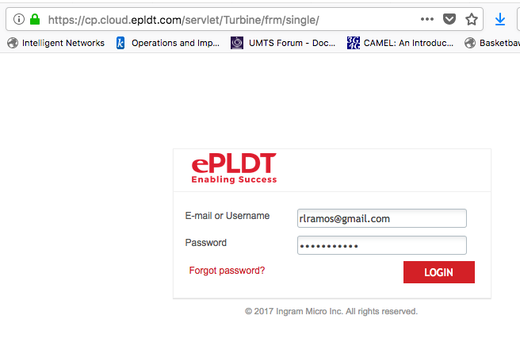
ePLDT Cloud Login
https://cp.cloud.epldt.com/

Slide 4
Username and Passwords
ePLDT UserName | Password
sweepuser01 | abalone34#*
sweepuser02 | abalone34#*
sweepuser03 | abalone34#*
sweepuser04 | abalone34#*
sweepuser05 | abalone34#*
sweepuser06 | abalone34#*
sweepuser07 | abalone34#*
sweepuser08 | abalone34#*
sweepuser09 | abalone34#*
sweepuser10 | abalone34#*
abalone34#* | abalone34#*
sweepuser12 | abalone34#*
sweepuser13 | abalone34#*
sweepuser14 | abalone34#*
sweepuser15 | abalone34#*

Slide 5
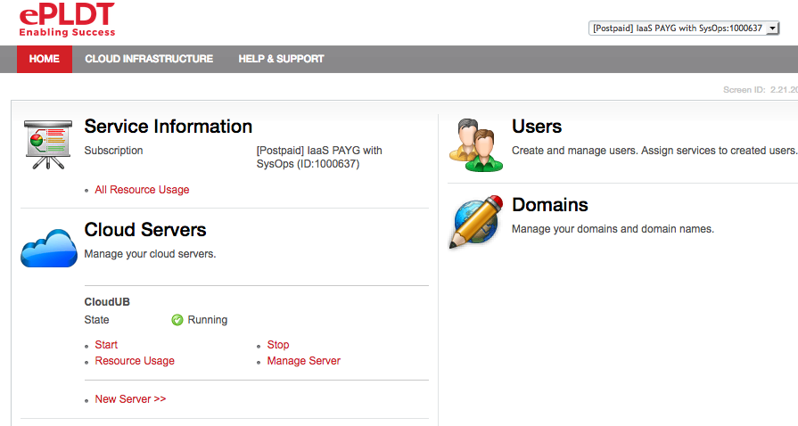
Create a New Server

Slide 6
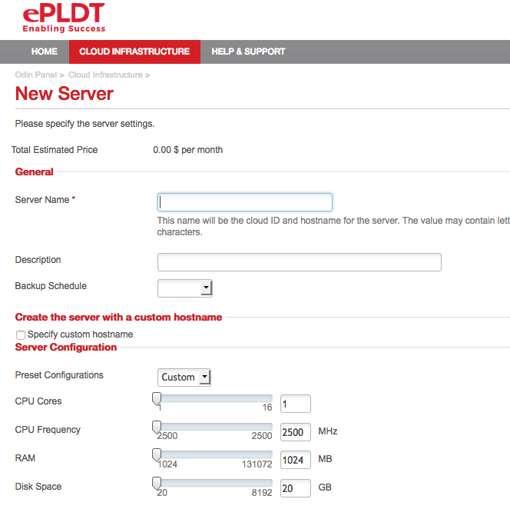
Create a New Server

Slide 7

STOP! Practice!
Login to the ePLDT cloud panel using your own account
Create a server (name it as sweep-yournickname) with the bare minimum requirements. It should be a Linux server using the latest Ubuntu version available
Do not put a public ip address on the server

Slide 8
STOP! Group Practice!
Login to the ePLDT cloud panel using your own account
Create a server (name it as sweep-yournickname) with the bare minimum requirements. It should be a Linux server using the latest Ubuntu version available
Once the server has been successfully created and is running open a command window and ping it’s IP address

Slide 9
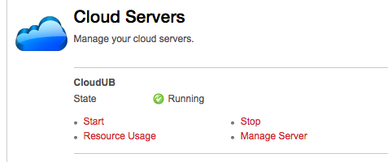
Manage the Server

Slide 10
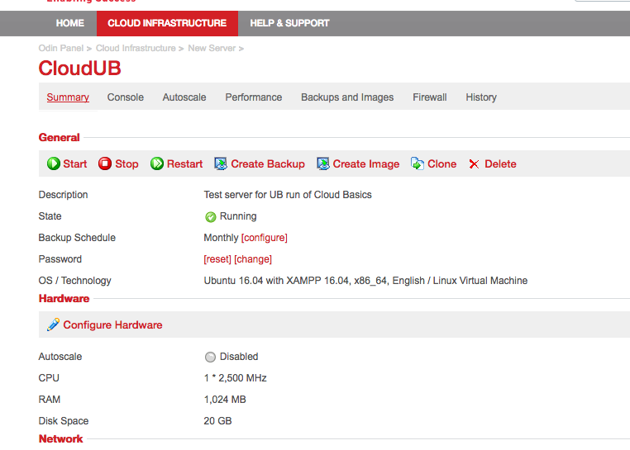
Manage the Server

Slide 11
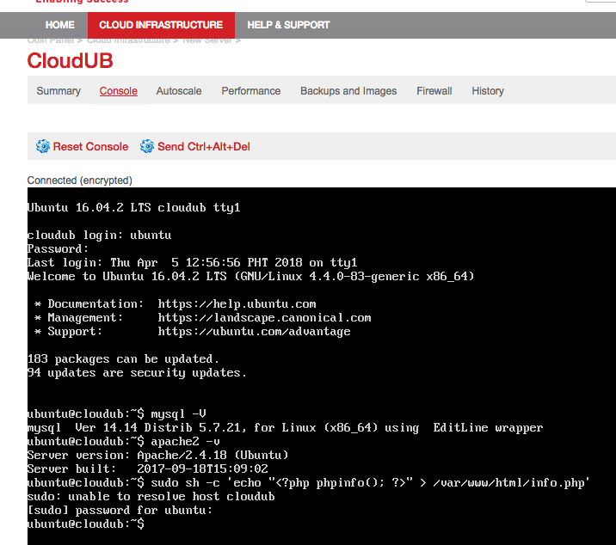
Working with the Server (Built in Console)

Slide 12

Change password for Root account
Login using the Ubuntu account
At the console prompt type: passwd

Slide 13
Add another user
At the console prompt issue the command:
sudo adduser <nameofuser>
You will be prompted to enter the password for the new user as well as a few extra pieces of information

Slide 14
Logout
From the console issue the command: logout

Slide 15
Commands so far
Change password: passwd
Create a new user: sudo adduser <nameofuser>
Logout: logout
Note:
sudo - There are two ways to run administrative applications in Linux. You can either switch to the super user (root) with the su command, or you can take advantage of sudo.

Slide 16
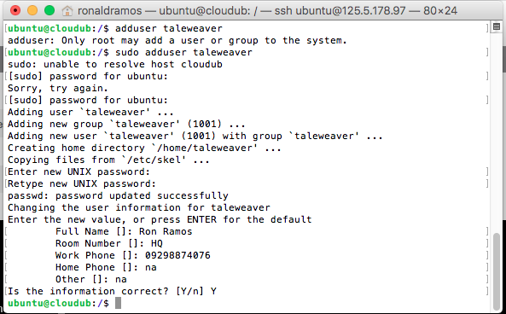
Working with the Server (SSH Client)

Slide 17
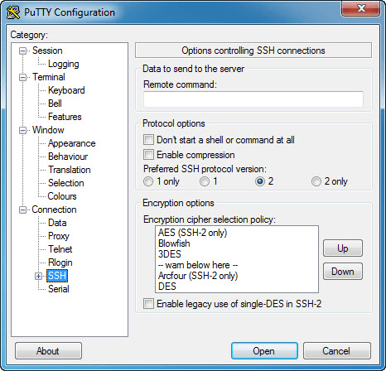
Please download PuTTY for Windows
https://www.putty.org/

Slide 18
Windows SSH Client
PuTTY is an SSH and telnet client, developed originally by Simon Tatham for the Windows platform. PuTTY is open source software that is available with source code and is developed and supported by a group of volunteers.
Notes:
https://www.chiark.greenend.org.uk/~sgtatham/putty/
https://www.putty.org/

Slide 19
SSH
The SSH protocol (also referred to as Secure Shell) is a method for secure remote login from one computer to another.
It provides several alternative options for strong authentication, and it protects the communications security and integrity with strong encryption.
It is a secure alternative to the non-protected login protocols (such as telnet, rlogin) and insecure file transfer methods (such as FTP).
Notes:
https://www.ssh.com/ssh/protocol/

Slide 20
Typical uses of the SSH protocol
The protocol is used in corporate networks for:
providing secure access for users and automated processes
interactive and automated file transfers
issuing remote commands
managing network infrastructure and other mission-critical system components.

Slide 21
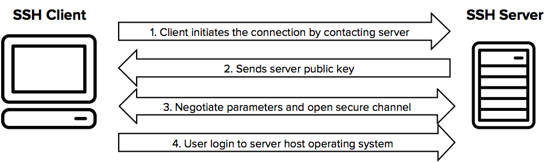
How does the SSH protocol work
Notes:
The protocol works in the client-server model, which means that the connection is established by the SSH client connecting to the SSH server. The SSH client drives the connection setup process and uses public key cryptography to verify the identity of the SSH server. After the setup phase the SSH protocol uses strong symmetric encryption and hashing algorithms to ensure the privacy and integrity of the data that is exchanged between the client and server.

Slide 22
SSH provides strong encryption and integrity protection
Once a connection has been established between the SSH client and server, the data that is transmitted is encrypted according to the parameters negotiated in the setup.
During the negotiation the client and server agree on the symmetric encryption algorithm
to be used and generate the encryption key that will be used. The traffic between the communicating parties is protected with industry standard strong encryption algorithms (such as AES (Advanced Encryption Standard)), and the SSH protocol also includes a mechanism that ensures the integrity of the transmitted data by using standard hash algoritms (such as SHA-2 (Standard Hashing Algorithm)).

Slide 23
Commands so far
sudo apt update – update the Advanced Tool Packager – a utility to download and install software packages on unix/linux
sudo apt install lamp-server^ --dwonloads and installs Apache2/MySql/Linux
After install:
  apache2 –v - to check if apache was installed and is running
  mysql –V – to check if mySql was installed and is running

Slide 24
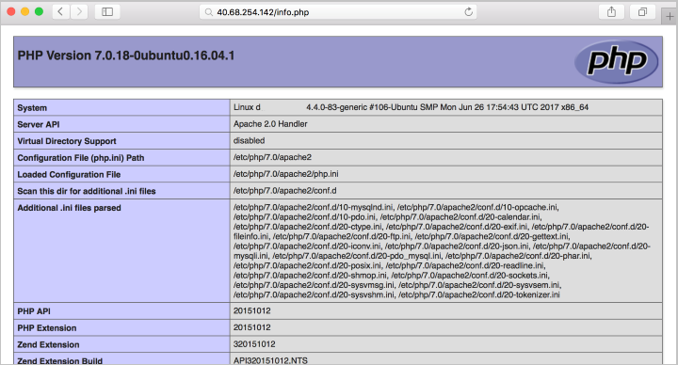
Test PHP install on your virtual server
Open a PuTTY connection and login
Issue the following commands:
  php –v - to check version of PHP on server
  sudo sh -c 'echo "<?php phpinfo(); ?>" > /var/www/html/info.php’ – creates a php page called info.php that returns system info
Go to a browser on your computer and enter:
  http://ServerPublicIPAddress/info.php
If successful you will get a PHP page containing server information

Slide 25
Add a user with sudo privileges
Create a new user:
sudo adduser <username>
Add user to the sudo group:
sudo usermod -aG sudo <username>
Switch to another user:
su - <username>
Test sudo privileges:
sudo ls -la /root - only a superuser can list the contents of the root directory

Slide 26
STOP! Group Work!
Create a new server. Name should be: ub2-yournickname. Don't forget to set at least 1 public ip address. Specs are default. OS is latest Ubuntu.
Once the server is up. Change the password for user ubuntu.
Once done, install Apache2/mySQL/PHP and test if they are working

Slide 27
End of Day 2

